Slide 1

Community Garden to Courtroom
Katherine Withers
Terry Bryant Law School Scholarship Program
June 2021

Slide 2
Growing up, I had always imagined my life’s purpose would be revealed to me with pomp and circumstance.
Perhaps all would be revealed in a dream or through an epiphany while kneeling at the presbytery.
Instead, I came to understand my life’s purpose while covered in dirt.
I was not kneeling at a church altar, but instead kneeling in the grass with mud under my fingernails as I worked in the community garden I had been running for the past two years.
Environmental advocacy is my true calling.

Slide 3
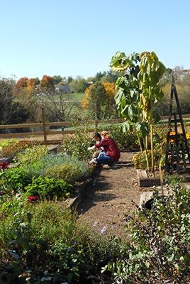

In college, I worked to establish three community gardens in elementary schools in Harrisonburg, Virginia.
I spent my evenings working with my professor on grant applications and my weekends coordinating garden maintenance and developing curriculum to allow for teachers to integrate the garden into their math, science, and writing lessons.

Slide 4
What started out as an opportunity to involve college students in environmental service learning quickly became an integral resource in the fight against childhood hunger.
73%
of children in Harrisonburg, Virginia are eligible for free/reduced lunch due to food insecurity. This is significantly higher than the state average of 45%.
Virginia Department of Education, VDOE National School Lunch Program Eligibility Reports. 17 July 2020. Microsoft Excel file. Web. 7 April 2021. [https://www.doe.virginia.gov/support/nutrition/statistics/index.shtml]

Slide 5
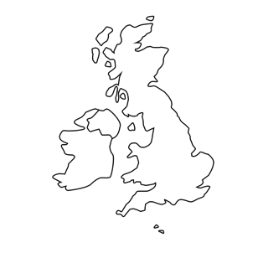
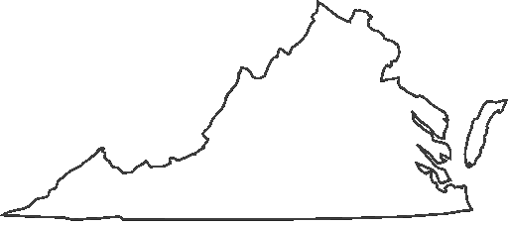
I continued this work as a graduate student where I lead the development of a community garden in the industrial neighborhood of Vauxhall, London.
I had witnessed how a garden could transform a community facing food insecurity and lack of access to green spaces, and even though I was in a foreign country, I felt inspired to continue that work in my new home. . From the garden, I built a community, formed relationships with my neighbors from across the globe, and overcame the isolation associated with being an expatriate.

Slide 6
In the low income neighborhoods of Harrisonburg and Vauxhall, environmental issues were disproportionately present in daily life.
These communities bear an inequitable share of environmental burdens compared to their higher income counterparts.
As time passed, my understanding of the role of the garden evolved from a community service project to a physical representation of the intersection of the environment and broader societal concerns.
My understanding of the environment expanded from something purely scientific to incorporate justice in environmental sustainability.

Slide 7
Climate change, deforestation, pollution, and the loss of biodiversity are not solely environmental issues.
They are also economic and social problems that are symptomatic of deeper systemic inequalities.

Slide 8
The COVID-19 pandemic undisputedly highlighted the overlap between poverty and environmental issues internationally. It serves as a stark example of the impact of unchecked environmental degradation on every facet of global society.
Environmental Impact on Human Health:
Habitat Loss
Increased Contact Between Wildlife + Humans
Spread of Zoonotic
Pathogens (i.e. COVID-19)
to Humans
Platto, S., Zhou, J., Wang, Y., Wang, H., & Carafoli, E. (2021). Biodiversity loss and COVID-19 pandemic: The role of bats in the origin and the spreading of the disease. Biochemical and biophysical research communications, 538, 2–13. https://doi.org/10.1016/j.bbrc.2020.10.028

Slide 9
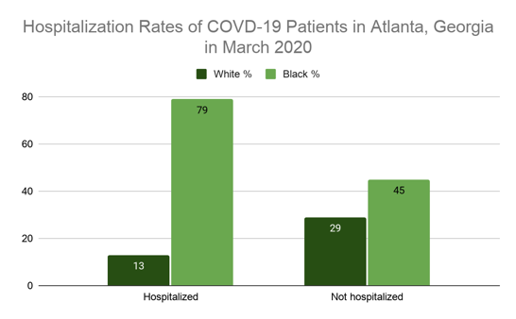
Livelihoods of half of the global workforce have been severely affected by the pandemic.
COVID-19 caused the first increase in global poverty in decades. Over 71 million people were pushed into extreme poverty.
Over 1.6 billion students are out of school - reversing years of progress on education.
In developed countries, COVID-19 fatality rates are highest among marginalized groups, including people of color.
In developing countries, the most marginalized, including women, the elderly, children, Indigenous people, and refugees, faced amplified consequences during the pandemic.
25 years of progress made towards developmental equality are being erased.
United Nations. (2020). The Sustainable Development Goals Report 2020. https://unstats.un.org/sdgs/report/2020/The-Sustainable-Development-Goals-Report-2020.pdf
Centers for Disease Control and Prevention. (2020, December). COVID-19 Racial and Ethnic Disparities. Centers for Disease Control and Prevention (CDC). https://www.cdc.gov/coronavirus/2019-ncov/community/health-equity/racial-ethnic-disparities/disparities-illness.html
United Nations. (2020). The Sustainable Development Goals Report 2020. https://unstats.un.org/sdgs/report/2020/The-Sustainable-Development-Goals-Report-2020.pdf

Slide 10





Urgent action is needed to address the issues that fall at the intersection of social and environmental issues.
Inequitable Access to Green Space
Public Health
Access to Water
Food Insecurity
Climate Change
Without prompt attention, climate change
could erode development gains and force
100 million people
into extreme poverty
by 2030.
The World Bank, Atlas of sustainable development goals 2017: from world development indicators, 71–79 (2017). Washington, DC.

Slide 11
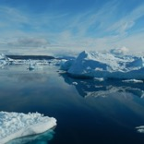
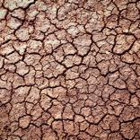
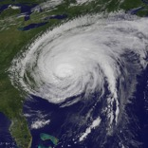
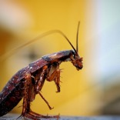
Climate change is already affecting every country on our planet.
Sea levels are rising leading to displacement of those living in coastal areas.
Droughts and heatwaves are increasing leaving agriculture vulnerable and leading to increased wildfires that destroy human life.
The intensity, frequency, and duration of hurricanes has been steadily increasing since the 1980s leaving many areas vulnerable to flooding, homes destroyed, and the destruction of infrastructure.
Warmer temperatures have lead to an increase in tree disease, insect outbreaks, and drought that reduces agricultural yield due to increasing length of frost-free periods.
NASA. (2020, December 23). The Effects of Climate Change. NASA. https://climate.nasa.gov/effects/.

Slide 12
While working in the community garden, I recognized the need for scientist-lawyers who can advocate for our environment and the people and places suffering from the consequences of environmental degradation.
I know this is where I can make a difference.
The role of science in environmental advocacy is distinctive. As an aspiring attorney, I can utilize my background in science to keep up with the ever-changing scientific body of knowledge that informs our policies and regulations. I am able to ensure individuals unfamiliar with environmental issues, like judges, corporate actors, and the public, understand and agree with my argument.

Slide 13



Justice and sustainability are interdependent;
both are necessary for the creation of an equitable environmental future.
When we address the environment’s impact on human society from a lens of environmental justice, we can create a more equitable society for all.

Slide 14
“‘I am the Lorax. I speak for the trees. I speak for the trees, for the trees have no tongues’. . . Now that you’re here, the word of the Lorax seems perfectly clear. Unless someone like you cares a whole awful lot, nothing is going to get better. It’s not.” - Dr. Seuss’ The Lorax
Seuss. The Lorax. Dr. Seuss collector's ed. New York: Random House, 1999-1971. Print.
The words of the Lorax are representative of the responsibility I have as a future attorney to advocate for those who “have no tongues.”
A legal education is a privilege I can use to champion legal causes for the benefit of those who may not be able to advocate for themselves.
Environmental and social issues are very real, complex problems that have a significant, tangible impact on communities locally and globally.
Entering the legal profession provides me with the opportunity to make a difference in the lives of those in need today, while simultaneously investing in the lives of future generations that will depend on our planet as their home.

Slide 15
The opportunity to protect the environment through advocacy is representative of the ideals that inspired me to study environmental science in the first place:
As an attorney, I look forward to protecting our planet, but also representing human interests.
Through the law, it is possible to ensure environmental risk is distributed fairly, job loss is minimized, and
access to natural resources is ensured for all.
the opportunity to make a difference in my community

Slide 16

As a law student, I look forward to continuing to pursue my passion for environmental advocacy, but I can’t do it alone.
The generosity of firms like Terry Bryant that choose to invest in the future generation of attorneys through scholarship funds is what makes the pursuit of my passion possible.
This investment will be put back into the community as I begin my journey to becoming a legal advocate for the people and planet that have become so important to me.
As an attorney, I will live out my duty of protecting our planet for the benefit of future generations like those children, covered in dirt, who originally inspired me in the garden.

